Slide 1

How to Program a Drone to Fly with Python.

Slide 2
Programming Background

Slide 3
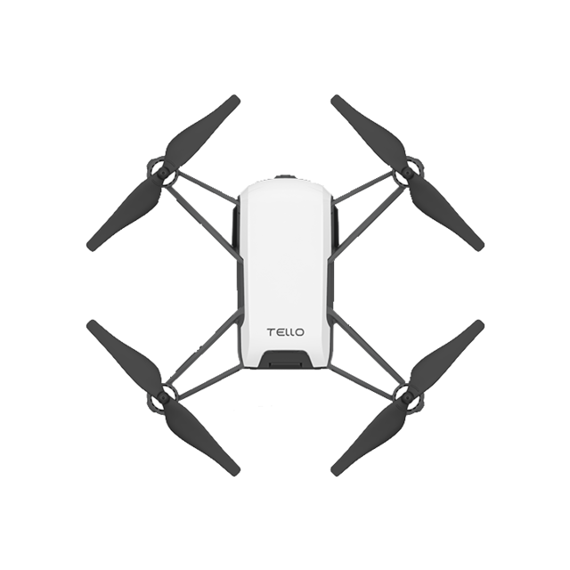
Did you know that instead of using a remote controller or mobile app, that you can write a computer program to fly a drone?

Slide 4
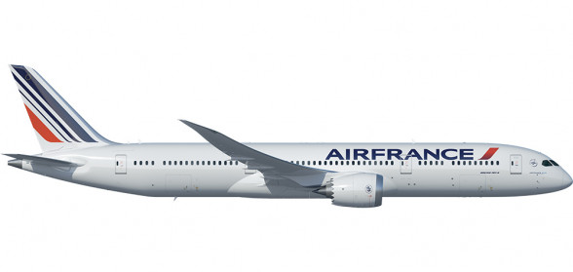
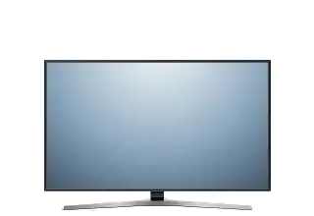
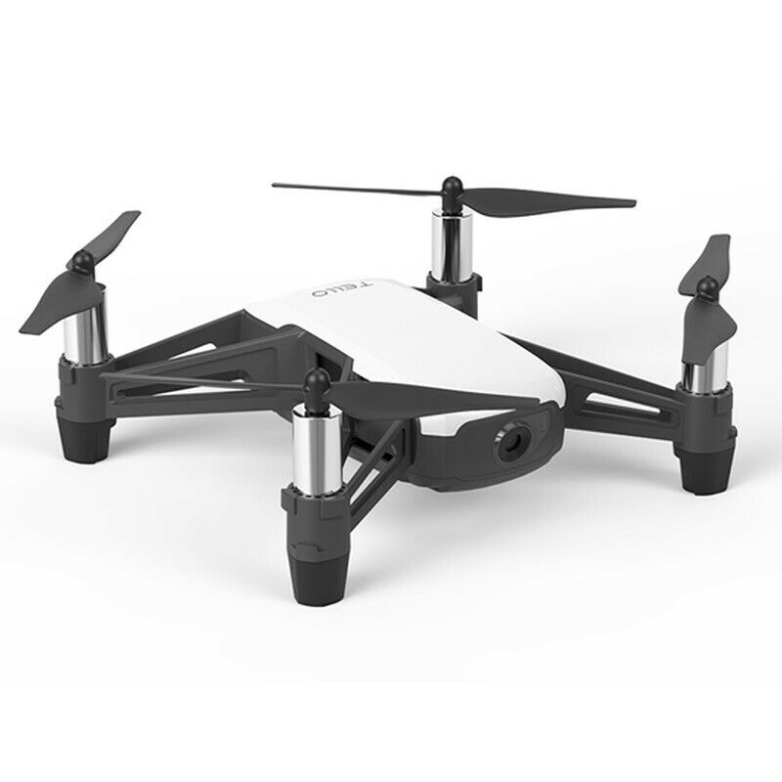
Many electronic devices are controlled by computer programs (also called software).

Slide 5
These devices use an Application Programming Interface or API to send commands to devices. An API translates computer programs into actions on a digital device. An API allows you to write computer programs for lots of different devices using the same programming language.

Slide 6
If you know the Python Programming language, you can write programs for hundreds of different devices like those on the next page which all have Python APIs.

Slide 7
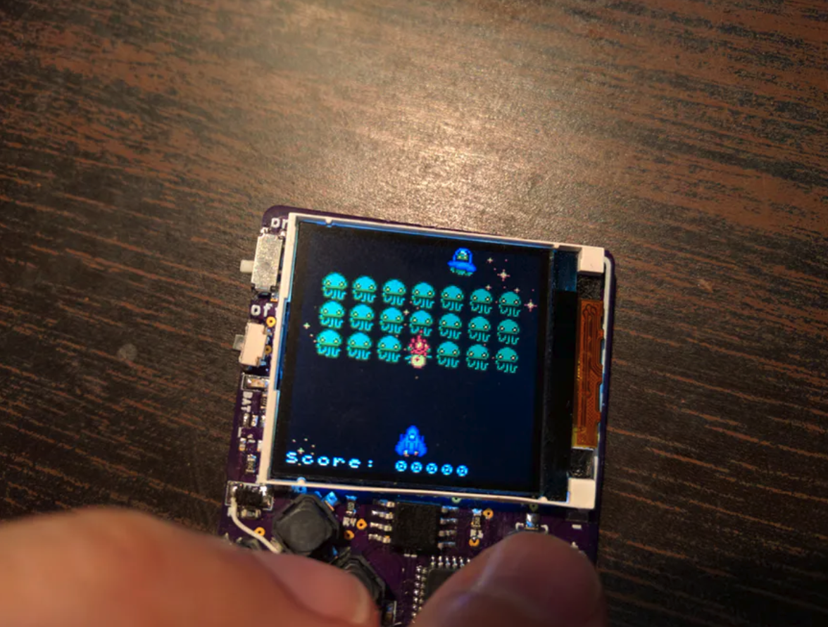
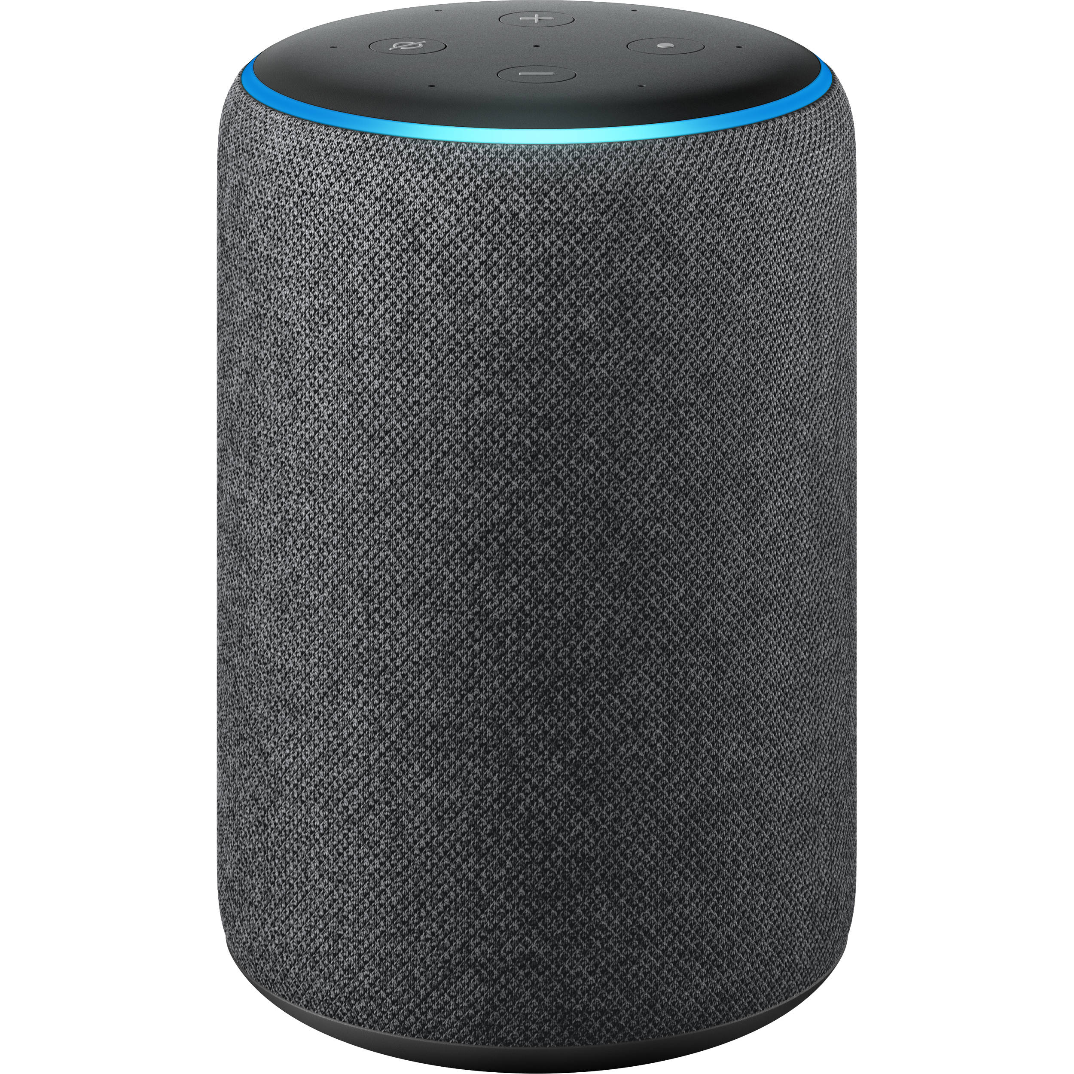
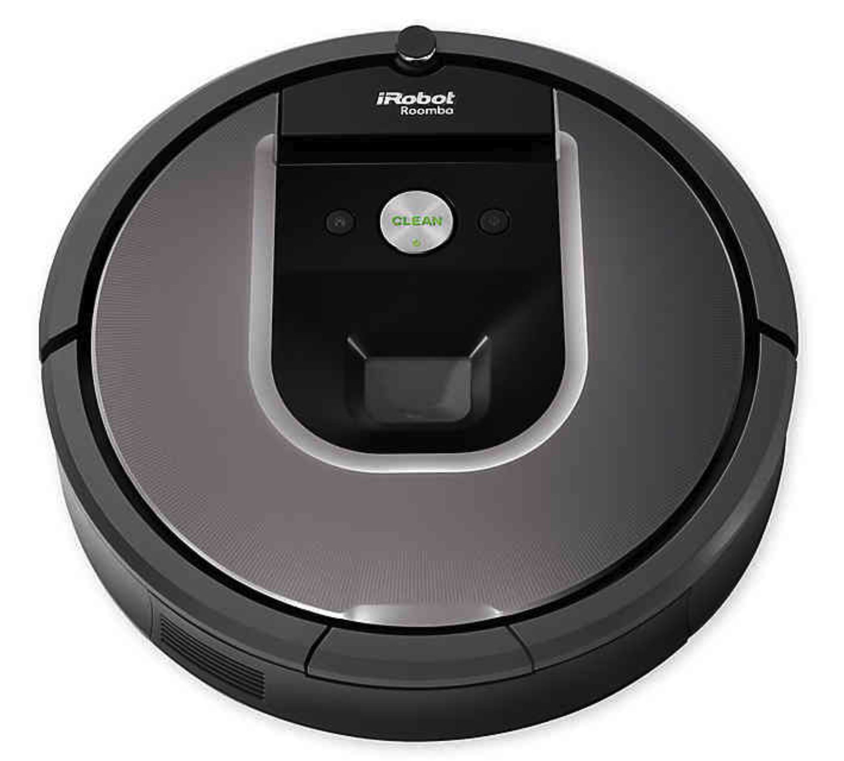
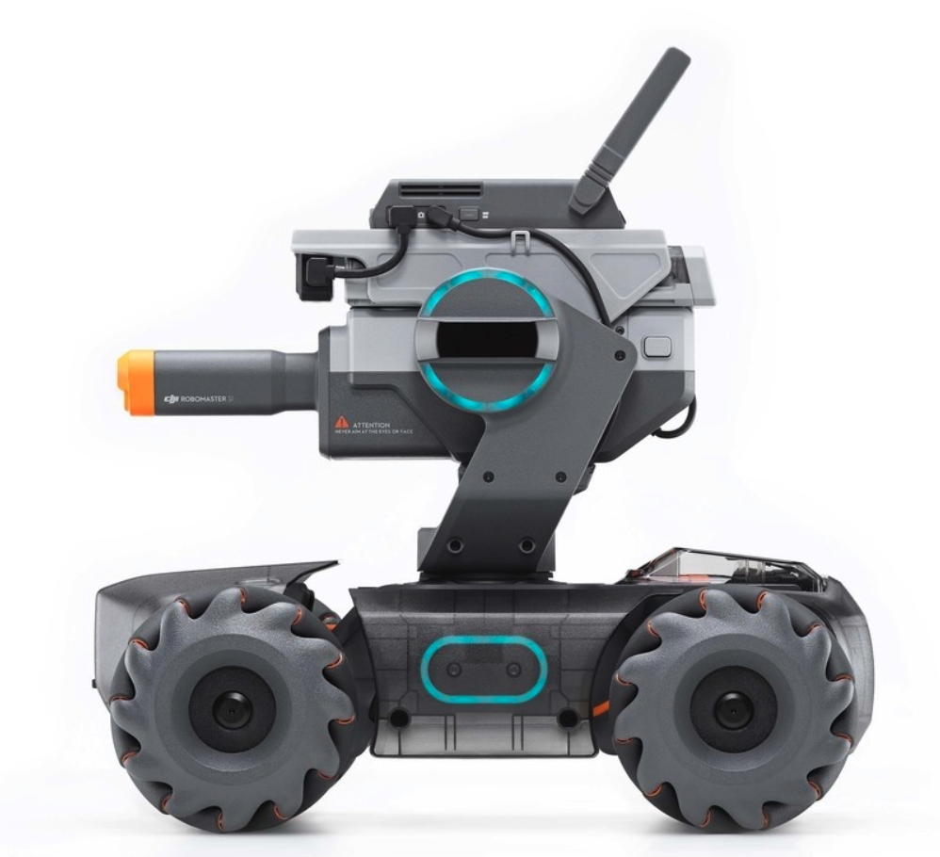
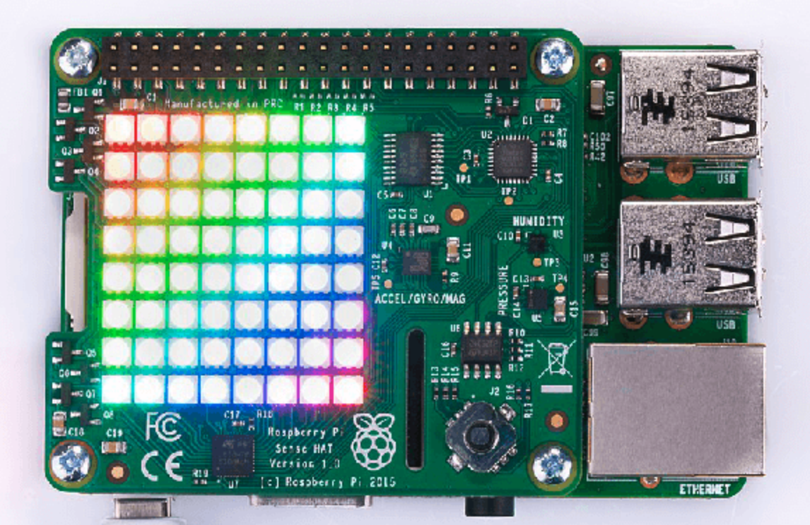
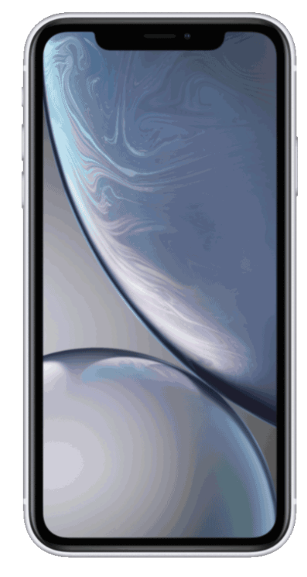
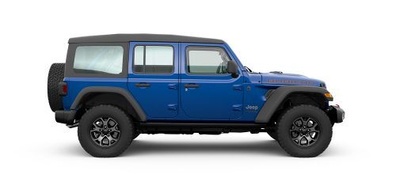
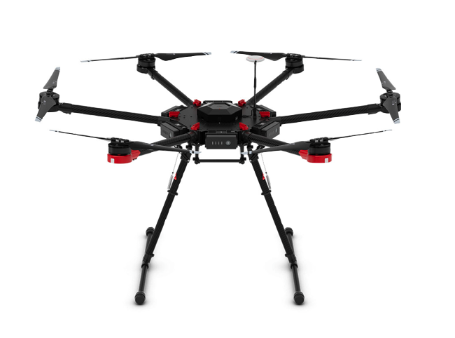
Notes:
https://micropython.org/
https://smartcar.com/docs/
https://github.com/dronekit/dronekit-python
https://github.com/NickWaterton/Roomba980-Python

Slide 8
Pretend you are building a new drone that takes pictures of crops growing in fields. How could you make the drone fly the same route every day at the same time?
Notes:
https://newsroom.statefarm.com/using-drone-technology-to-help-define-risk/

Slide 9
Python Program
“API, tell the drone to fly forward”
“OK, I’ll send your command to the drone”
“OK, API, I will fly forward”
API
Device

Slide 10
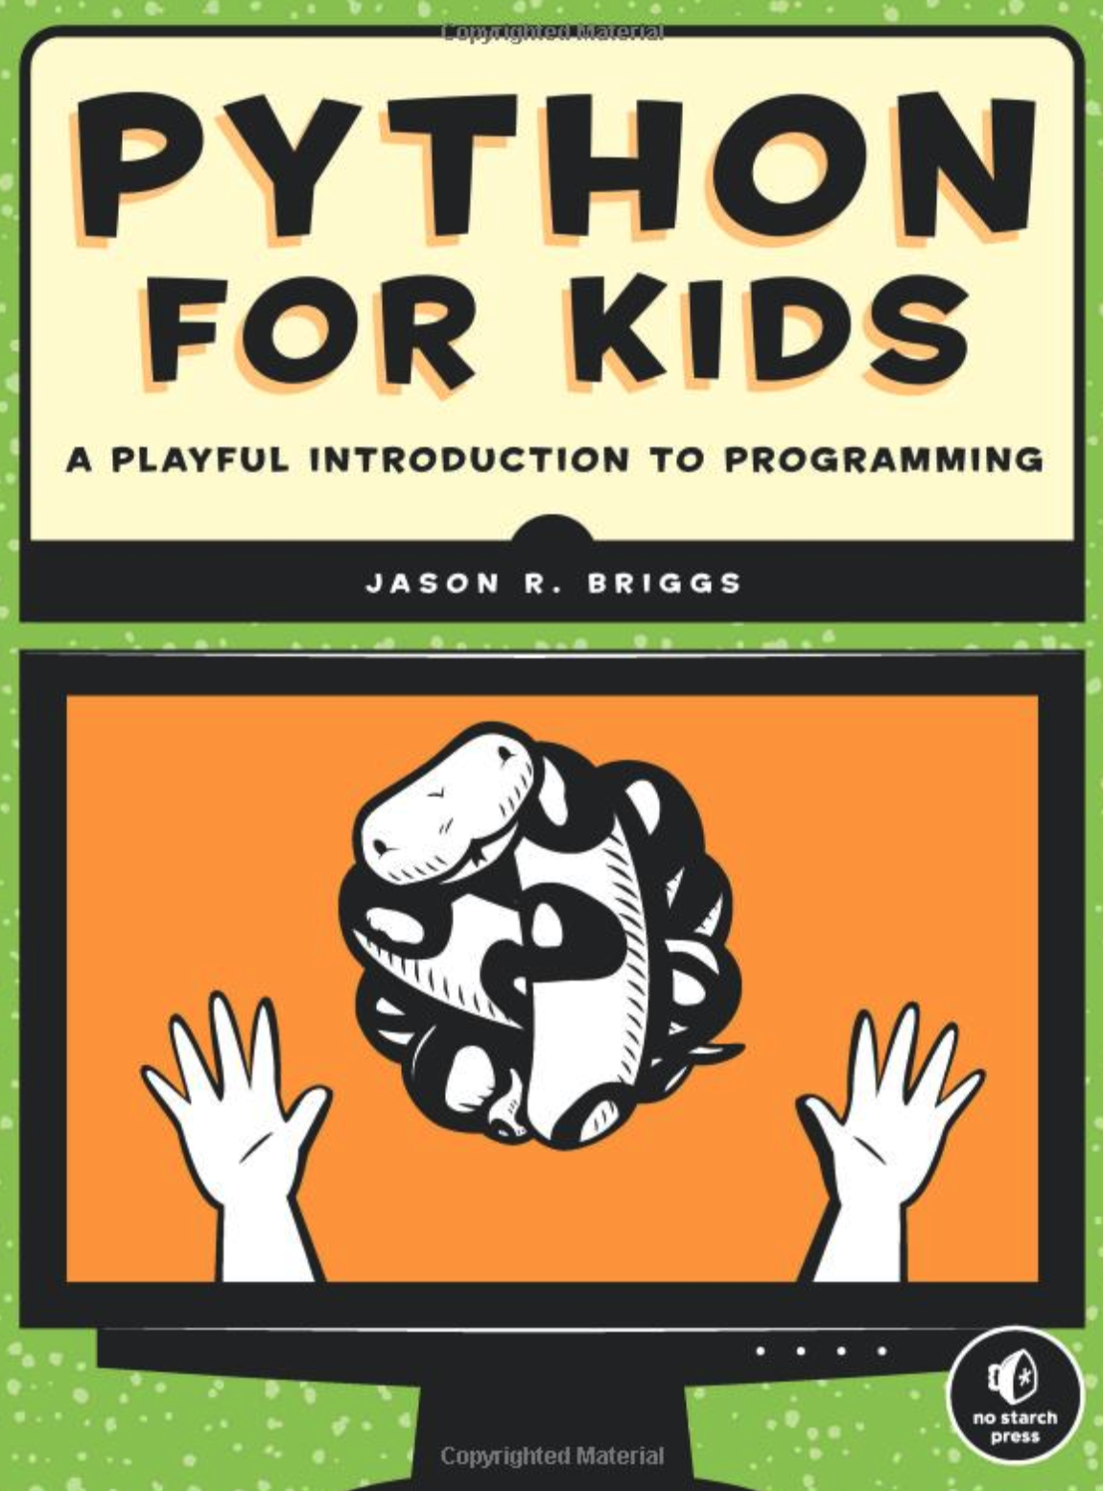
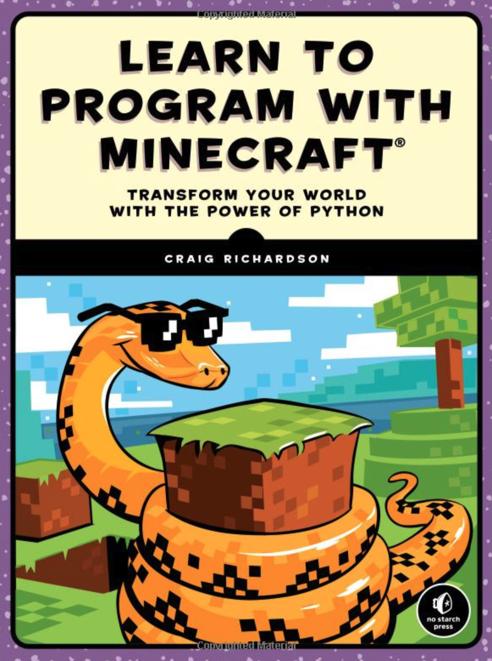
The Python programming language is one of the easiest, but also most powerful languages to learn.

Slide 11
Programming the Drone

Slide 12
So what does a real Python program look like?
On the next page, can you guess what these real Python commands are telling the drone to do?

Slide 13
drone.takeoff()
drone.move_forward(50)
drone.rotate_counter_clockwise(90)
drone.flip(“f”)
drone.land()

Slide 14
After the period, we have our command which is known as a “method” or “function”. This method tells the drone to fly forward.
This is the name of your drone in the program which is known as an “object”. We named the drone “drone”, but we can use any name.
drone.move_forward(50)
Inside the parentheses, we are telling the drone how far forward to go. In this case, the “forward” method needs to know how far to go forward in centimeters. This is called a “argument” and can be any valid number for this method.
The period separates our object from the command we want to send to the drone.

Slide 15
This is the name of your drone in the program which is known as an “object”. We named the drone “drone”, but we can use any name.
This method tells the drone to rotate clockwise.
drone.rotate_counter_clockwisew(90)
In this case, the method needs to know the number of degrees to rotate. You can use any number to tell the drone how much to rotate.
The period separates our object from the command we want to send to the drone.

Slide 16
This is the name of your drone in the program which is known as an “object”. We named the drone “drone”, but we can use any name.
This method tells the drone to flip.
drone.flip(“f”)
Inside the parentheses, notice the “f” is inside quotation marks. Valid values here include the following:
“l” - left
“r” - right
“f” - forward
“b” - back
The period separates our object from the command we want to send to the drone.

Slide 17
This method tells the drone to takeoff and must be run before any other commands.
This is the name of your drone in the program which is known as an “object”. We named the drone “drone”, but we can use any name.
drone.takeoff()
In this case, because there is only one way to takeoff, there are no arguments required within the parentheses.
The period separates our object from the command we want to send to the drone.

Slide 18
Python Command | English Translation
drone.takeoff() | Drone, takeoff.
drone.land() | Drone, land.
drone.move_up(25) | Drone, fly up 25 centimeters.
drone.move_down(25) | Drone, fly down 25 centimeters.
drone.move_left(25) | Drone, fly left 25 centimeters.
drone.move_right(25) | Drone, fly right 25 centimeters.
drone.move_forward(50) | Drone, fly forward 50 centimeters.
drone.move_back(50) | Drone, fly backward 50 centimeters.
drone.rotate_clockwise(90) | Drone, rotate in place 90 degree clockwise.
drone.rotate_counter_clockwise(90) | Drone, rotate in place 90 degree counterclockwise.
drone.flip(“f”) | Drone, do a forward flip. Valid params are “f”, “b”, “l” or “r”.

Slide 19
Models and Simulations

Slide 20
How do you think computer programmers test their programs for computer controlled machines like self-driving cars, rockets, and flying drones?
What happens when the computer program has mistakes in it?

Slide 21
When mistakes in a computer program can cause a machine like a rocket or drone to crash, programmers often use a computer simulation to test the software before using it in the real world.

Slide 22
Simulation
Production
Program
Program
Software
Software
Simulation Program
Real Rocket
Test Results
Rocket Flies or Crashes (Real Results)

Slide 23
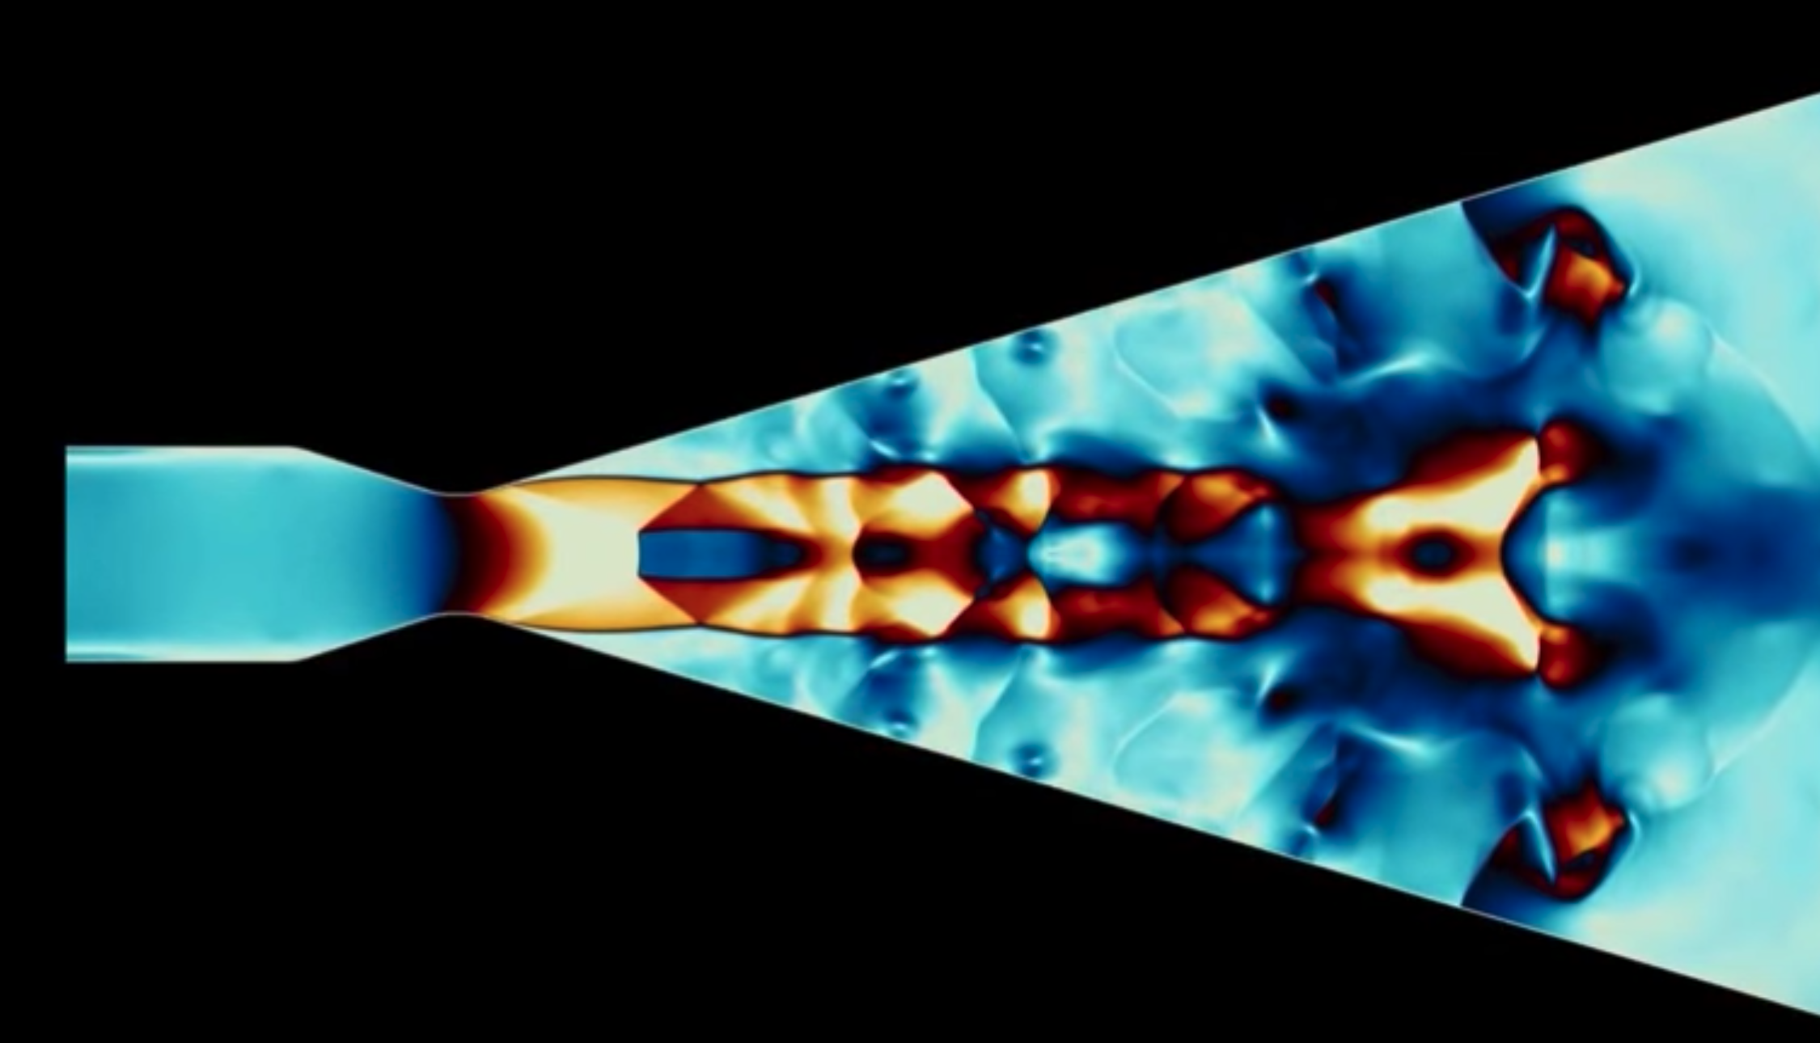
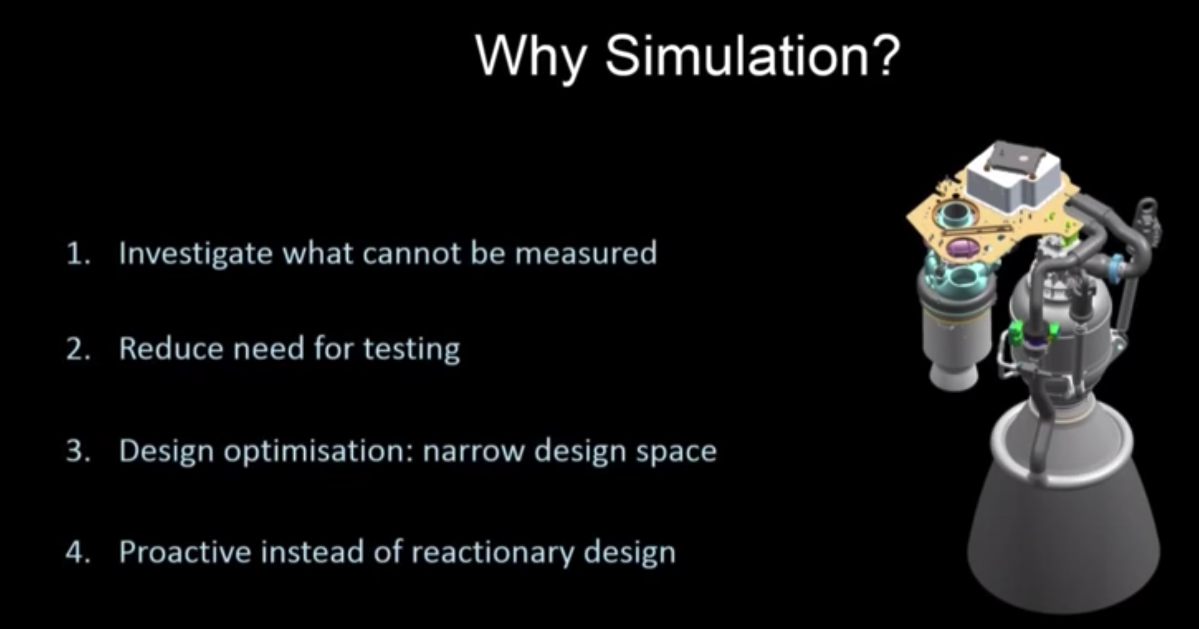

Slide 24
So, we are also going to use simulation to program our drone flights. This will allow us to test our program before we send it to a real drone.

Slide 25
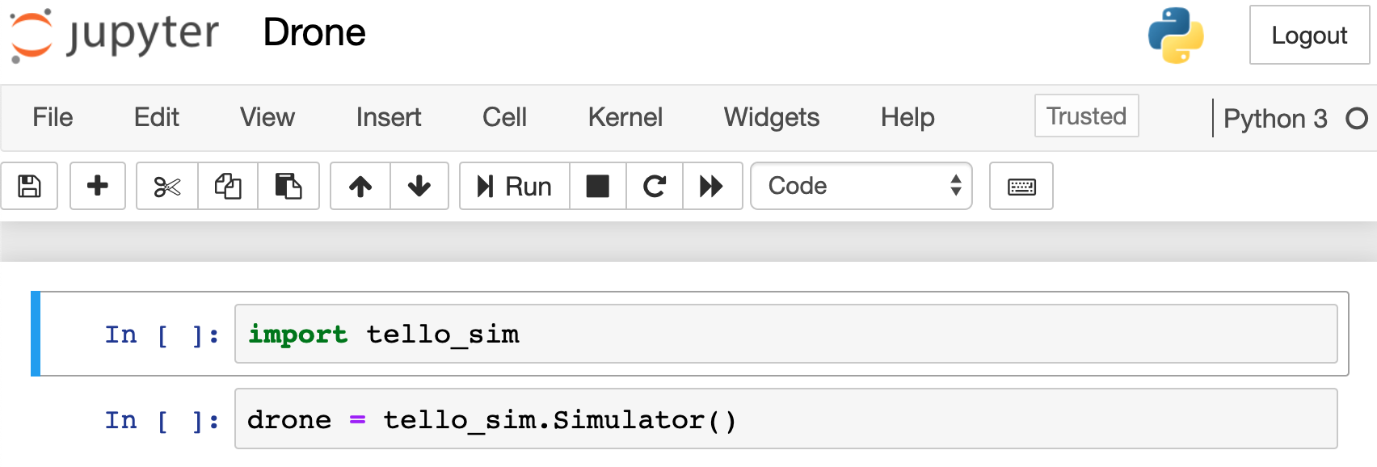
Once we open up Jupyter in our web browser, we can start writing our drone simulation program. The two commands shown below get us started.
This command loads our simulation software.
This command makes a Python object called “drone”.

Slide 26
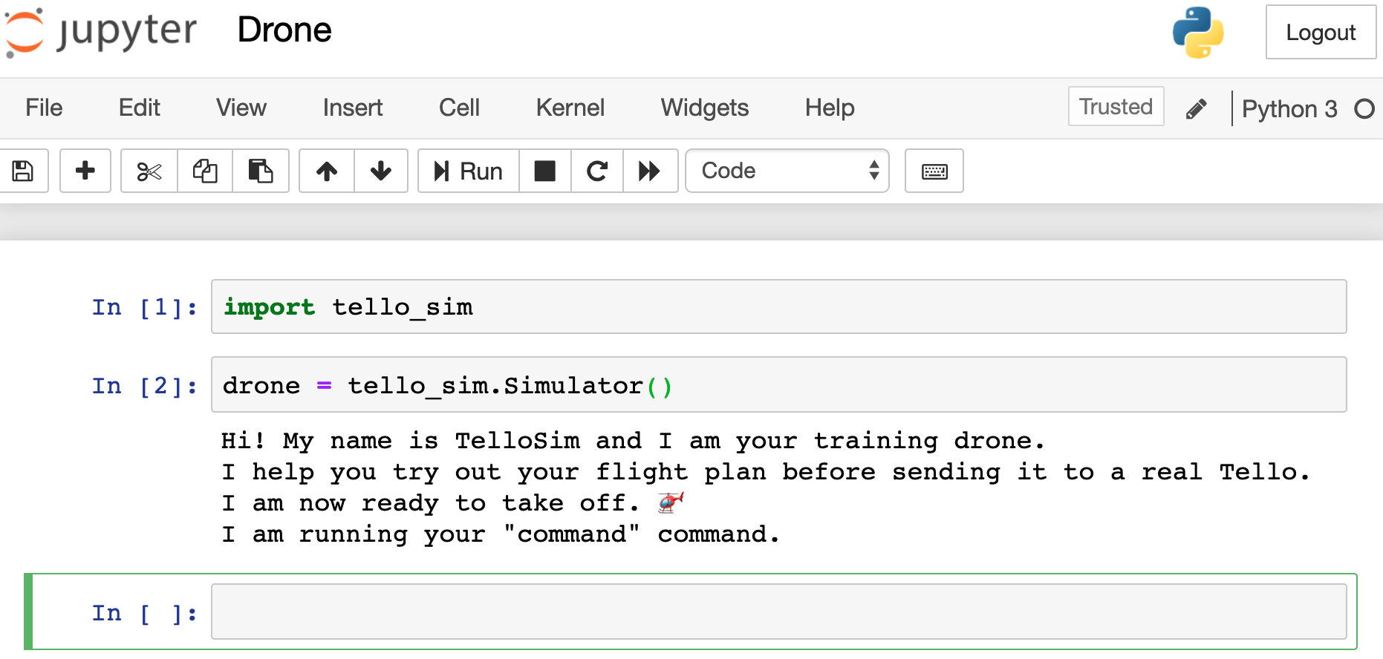
If our commands are run correctly, we should see the following output.

Slide 27
What do you think our simulation will do if we make a mistake in our program? For example, what it we try to flip the drone before we take off?

Slide 28
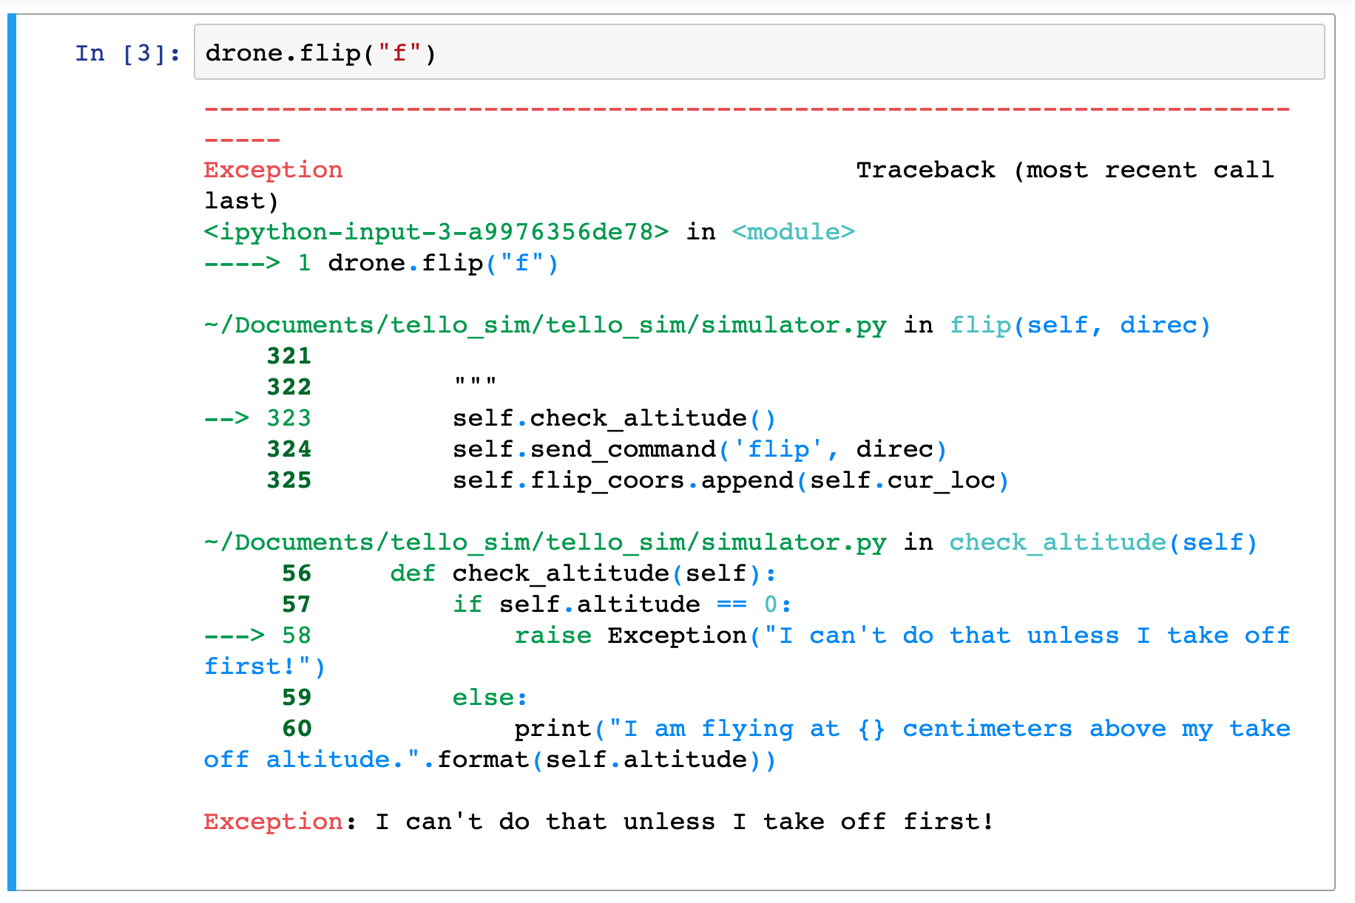
This is what an error looks like. We can see at the bottom, that the error tells us what we did wrong.

Slide 29
Drone Program Commands

Slide 30

Parentheses around parameter.
drone.move_forward(50)
Lower case. No spaces.
Whole number without quotation marks.

Slide 31
Parentheses around parameter.
drone.flip(“f”)
Lower case. No spaces.
Letter inside quotation marks.

Slide 32

drone .move_forward(50)
Extra space.

Slide 33
Drone.Move_Forward(50)
Not lower case.

Slide 34
Quotation marks around number.
drone.move_forward(“50”)

Slide 35
Letter parameter needs quotation marks.
drone.flip(f)

Slide 36
Now, let’s look at what the simulator does when we have a flight program with no errors. For this flight, we will:
Take off
Fly forward 50 centimeters
Turn right 90 degrees
Fly forward 100 centimeters
Land

Slide 37
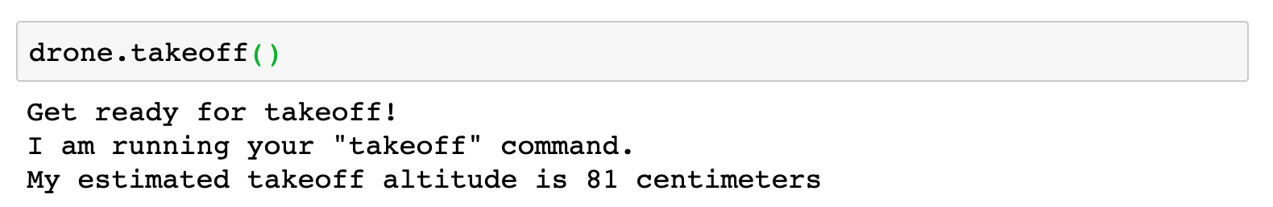

Slide 38
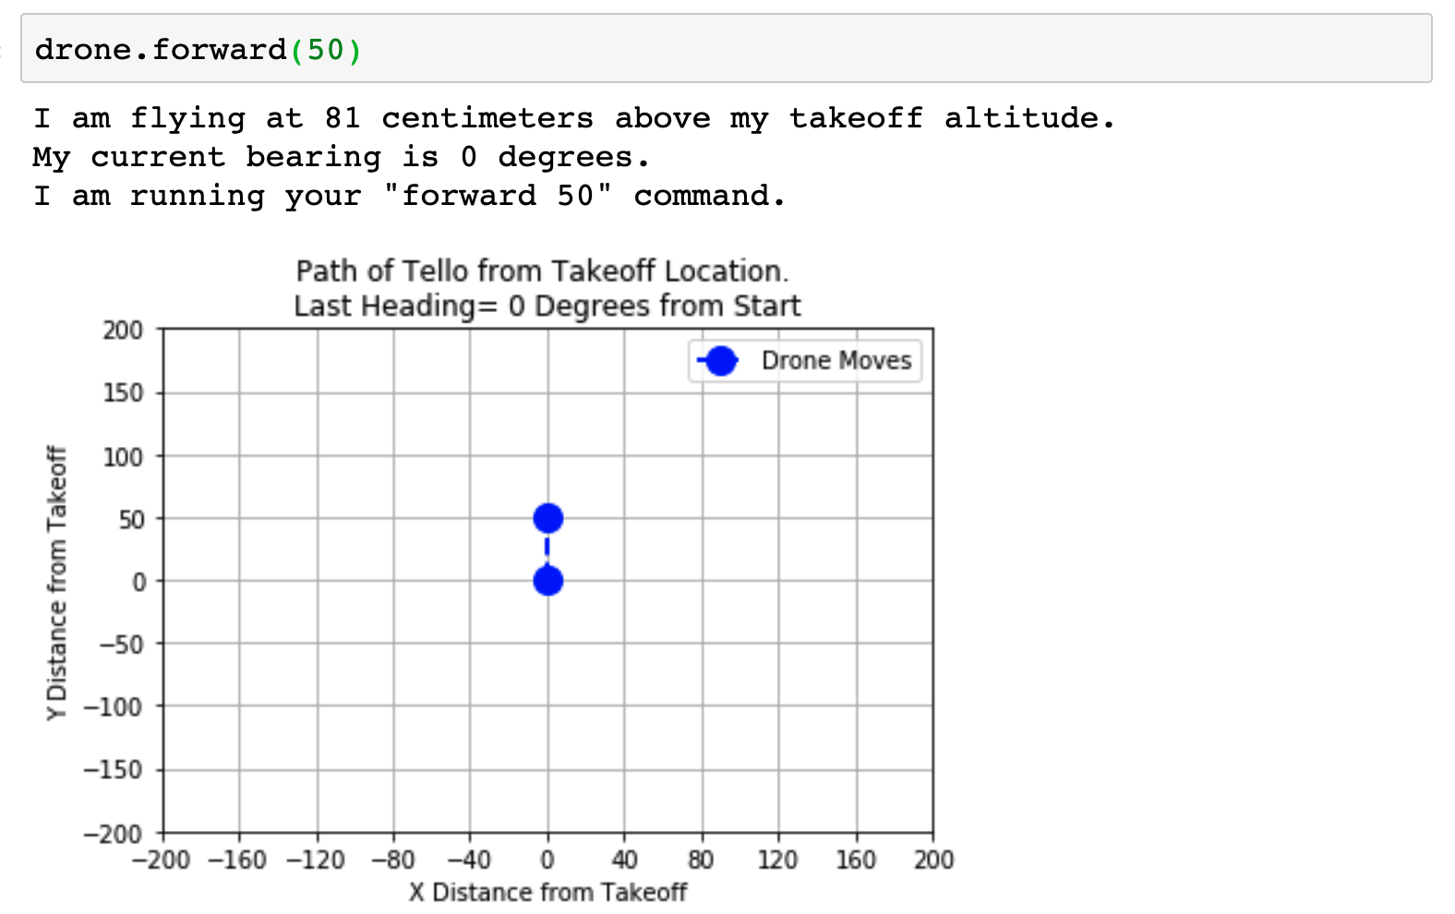

Slide 39
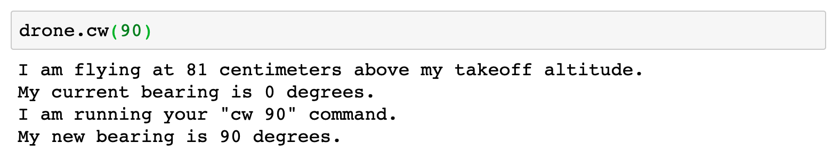

Slide 40
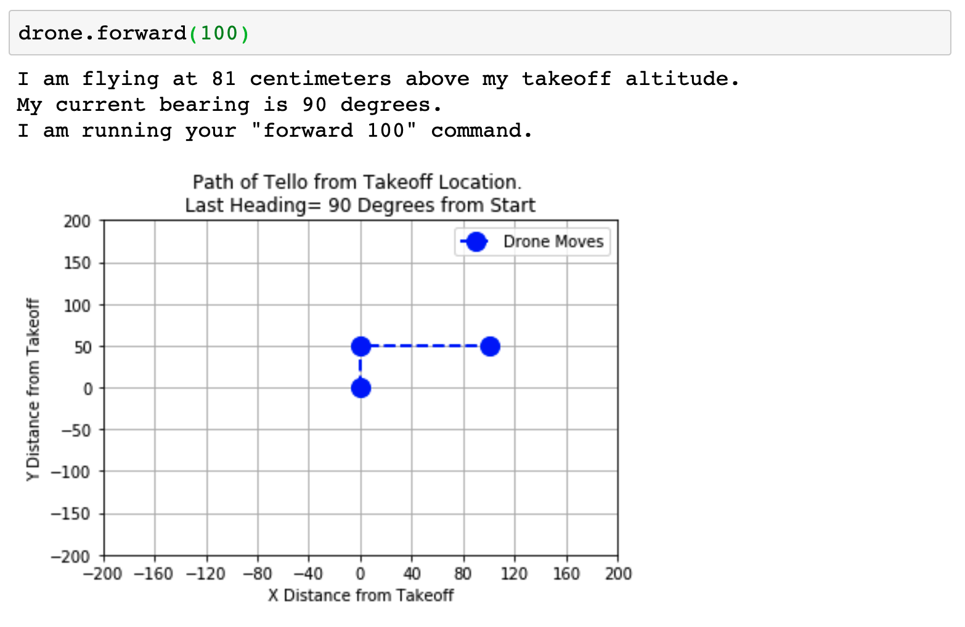

Slide 41
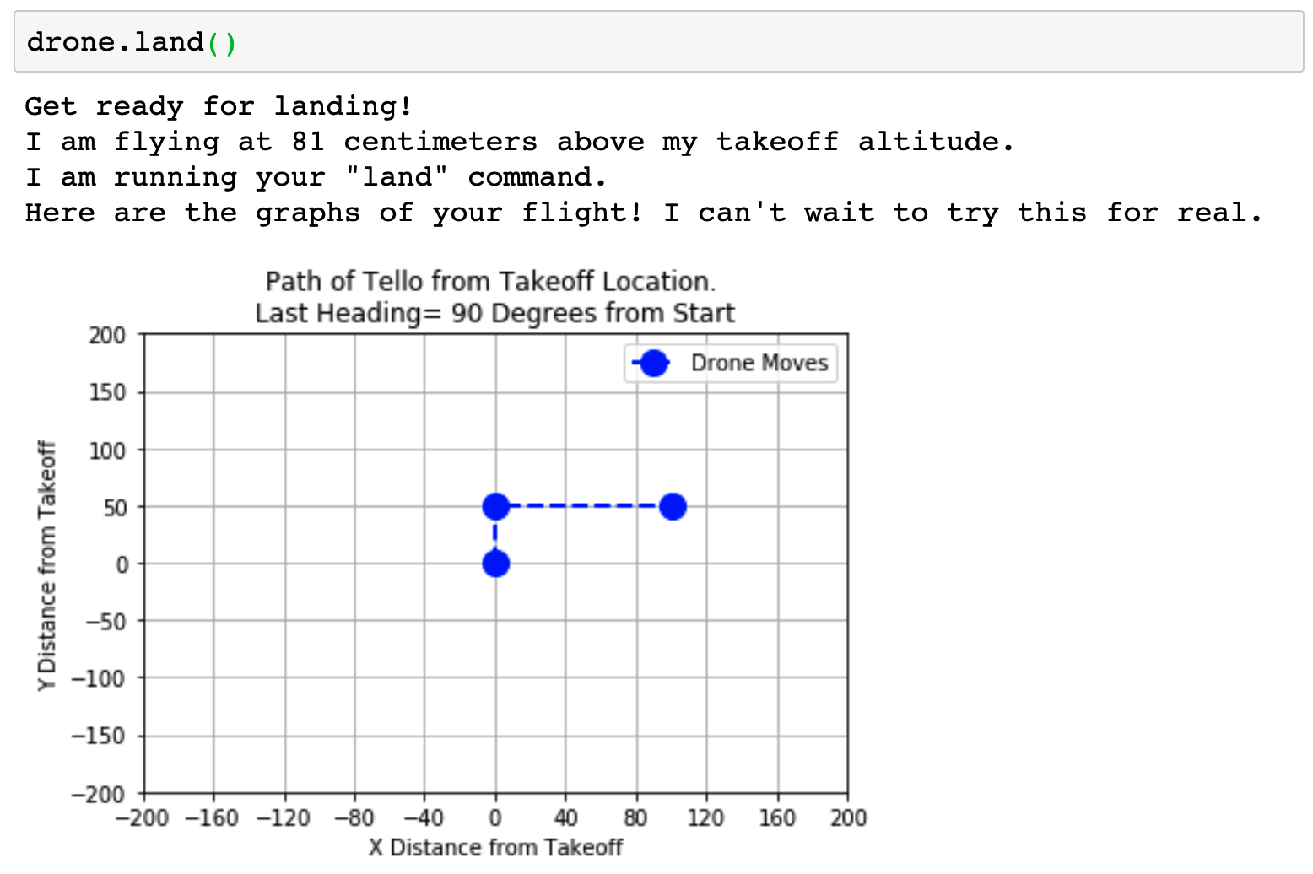

Slide 42
Sending Your Program to a Real Drone

Slide 43
There are two different ways to send our program to a real drone to test it in the real world.

Slide 44
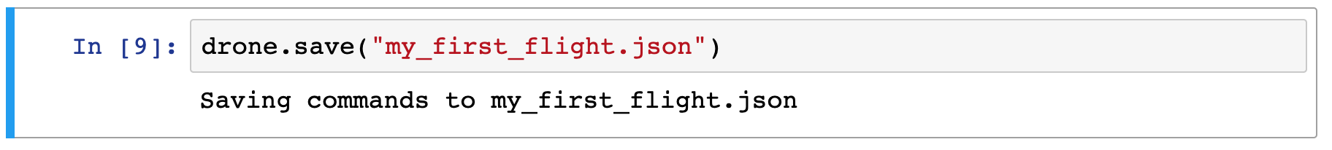
Save our program and send it to someone else to run.
This can be any file name

Slide 45
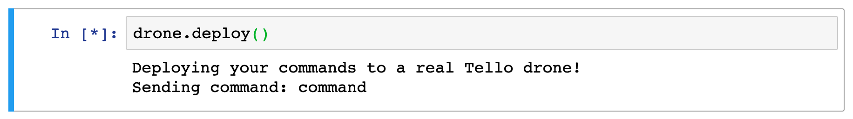
Connect to the Tello drone using your WiFi connection and send your program to the drone.

Slide 46
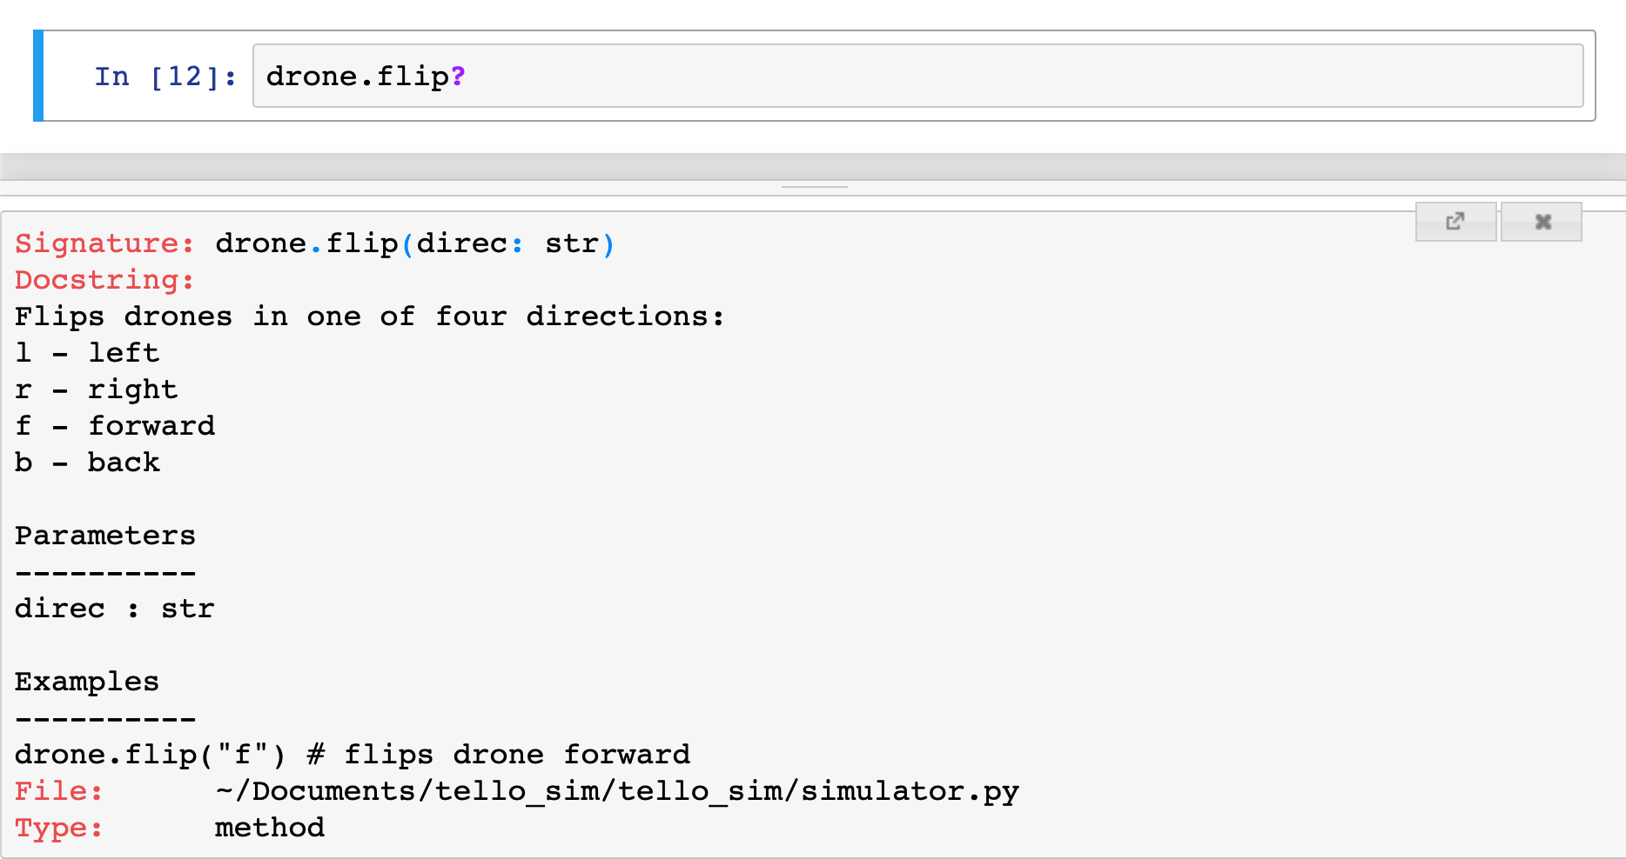
You can get help in your Jupyter Notebook by running a command with a question mark after it.

Slide 47
In-class Drone Exercise

Slide 48
STEP 1: Measure the drone course to build your flight program. Record the measurements to use when you are programming.
landing
5
takeoff
1
2
3
4

Slide 49
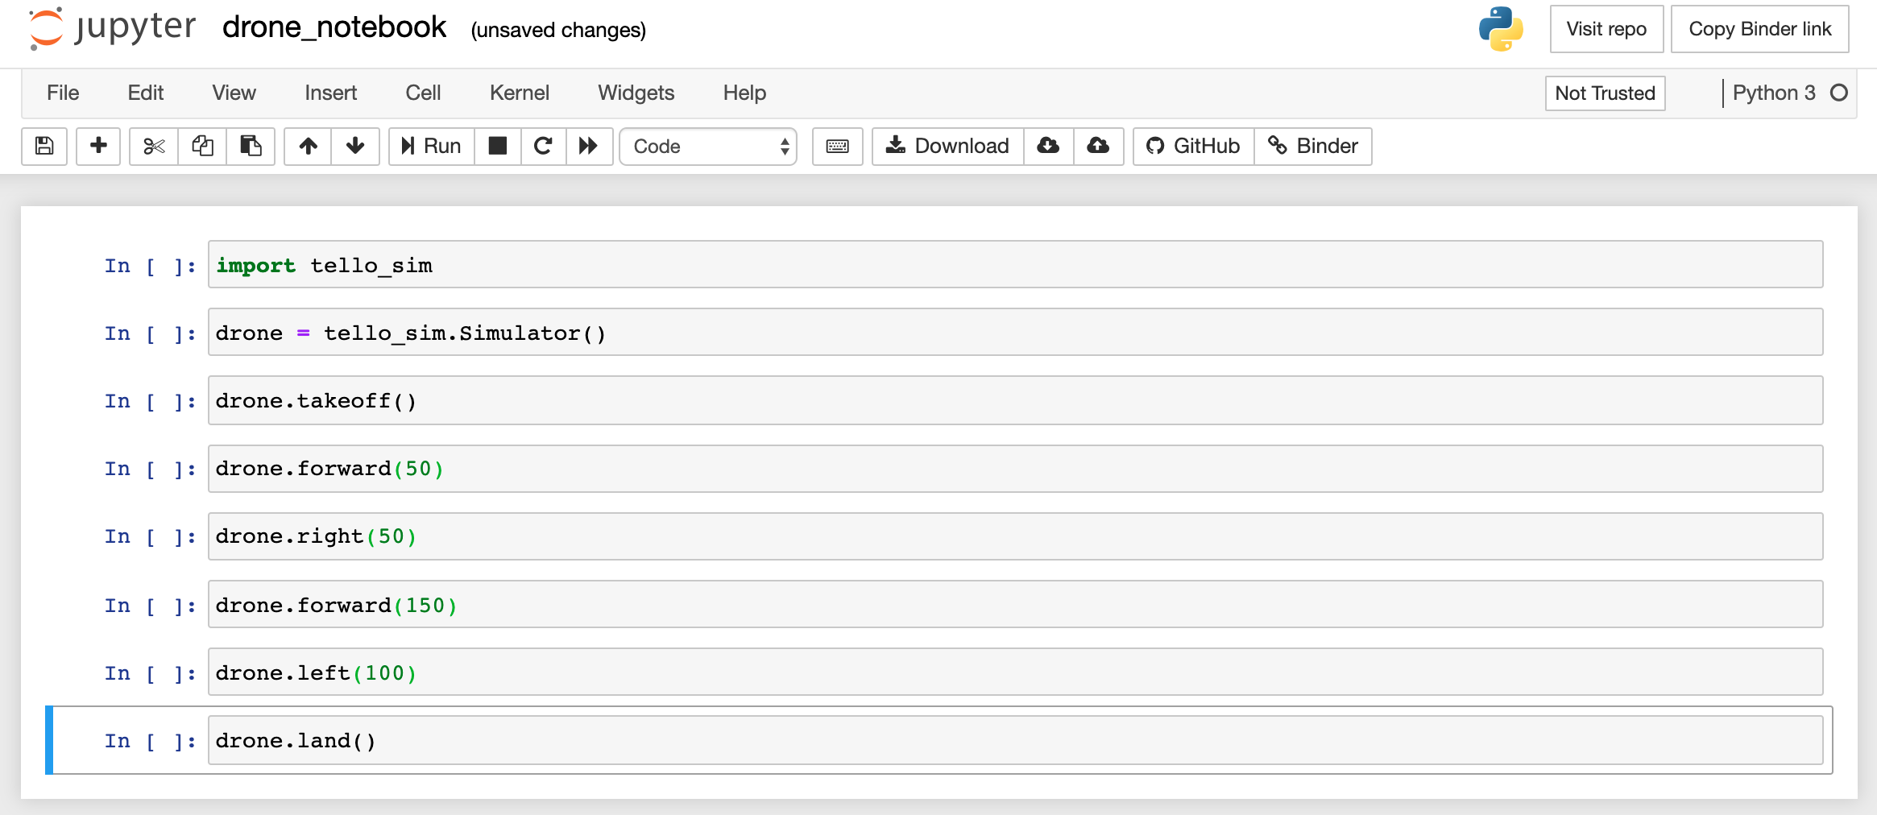
STEP 2: Create your programmed flight plan. Each line of your program is a different step for the drone.

Slide 50
Run Your Simulation

Slide 51
STEP 3: The simulation will test your code and output a simulated path or model of your drone’s flight. If your program has no errors, when you run “all cells”, it will output plots of your flight path step by step.
Simulated Path
landing
50 cm
100 cm
takeoff
50 cm
150 cm

Slide 52
Did your program work as you expected?
Did the plots of the flight path match your plan?

Slide 53
Test Your Model With a Real Drone

Slide 54
STEP 4: Finally, you will deploy your programmed flight path to the drone and test it by connecting to the drone WiFi and deploying your code. The actual flight will likely differ from your model path.
Simulated Path
Actual Path
landing
50 cm
100 cm
takeoff
50 cm
150 cm

Slide 55
Did the drone perform as expected?
Where did the actual flight differ from the simulated flight?
What are some reasons for these differences?
If you flew your flight plan more than once, were there differences in the actual flight using the same program?
Why might there be differences?
How could the simulation be made more accurate?
Could you adjust your program to make your actual flight better match your planned path?

Slide 56
Models

Slide 57
Can you think of any simulations or models that are used for natural phenomena?
Why might such models be useful?
Can you think of any other simulations or models that are used for used for man-made or designed systems?
Why might such models be useful?

Slide 58
Word or Term | Definition
Computer Program | A computer program is a collection of instructions that performs a specific task when executed by a computer.
Computer Programming Language | A specific set of instructions that can be used to program a computer. This includes rules for what is correct and how to accomplish tasks.
Python | A computer programming language that is easy to learn, but also very powerful.
Computer Software | Computer software is a collection of instructions or programs that performs a specific task when executed by a computer.
API | A application programming interface is a program that translates instructions from a programming language to another system to make controlling a system easier.
Computer Simulation | A computer program that acts like a real device to test programs to see how they work in a safe environment.

